Slide 1
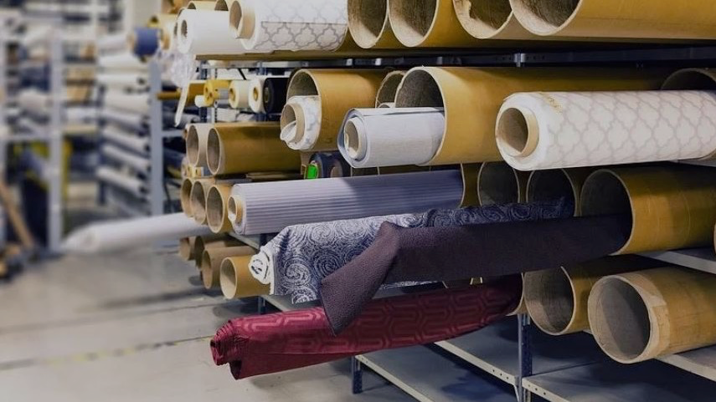
Textile Error Detection Smart Manufacturing Initiatives IOD Capstone Project
Sang Don Lee 03/12/2020

Slide 2
BIO
Data Science Student at Institute of Data
Senior Solutions Engineer / Technical Team Lead
Over 17 years of experiences in E2E implementation of Media Security

Slide 3
AGENDA
1. PROJECT CONTEXT
2. ADDRESS PROBLEMS
3. PRE-PROCESSING
4. DESIGN
5. Summary & Possible E2E Solution

Slide 4
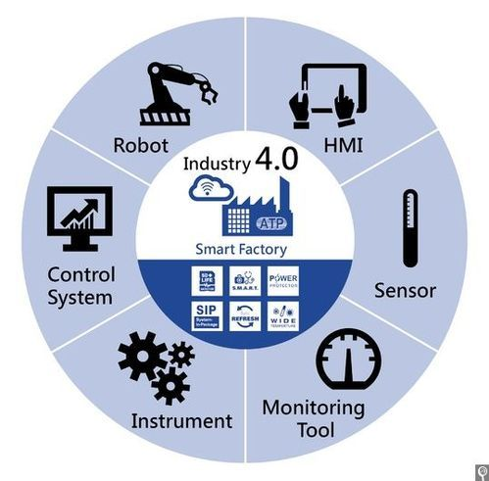
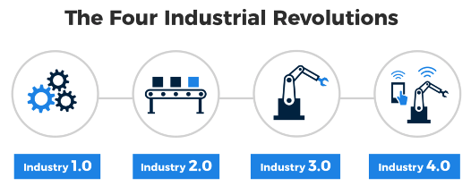
Industry 4.0 & Smart Factory
Industry 4.0 – 4th Industry Revolutions
Economic Impact from Smart Factories, value add $1.5T to $2.2T between 2017 - 2023**
source: https://www.capgemini.com/au-en/news/smart-factories-set-to-boost-global-economy-by-1-5-trillion-by-2023/

Slide 5
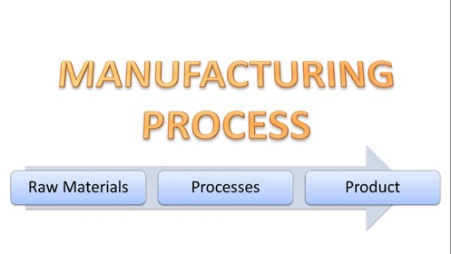
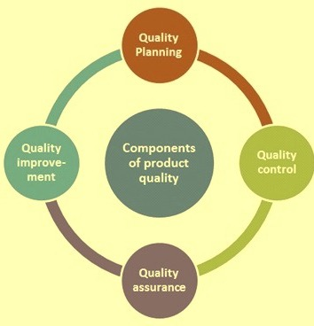
MANUFACTURING PROCESS
QUALITY COMPONENTS
QUALITY PLANNING
QUALITY CONTROL
QUALITY ASSURANCE
QUALITY IMPROVEMENT

Slide 6
AGENDA
1. PROJECT CONTEXT
2. ADDRESS PROBLEMS
3. PROEJCT DESIGN
4. PROJECT DELIVER
5. Summary & Possible E2E Solution

Slide 7
ADDRESS PROBLEMS
STAKEHOLDERS
Textile Manufacturers
Business Owners, QC Managers, Procurement
BUSINESS/DATA
QUESTIONS
We want to initiate Smart Factory transform for a long term
We have less than 70% of textile defect detection rate relying on skilled QC Staff
For a start, how can we implement autonomous textile defect detection and improve its rate?

Slide 8


Current…

Slide 9
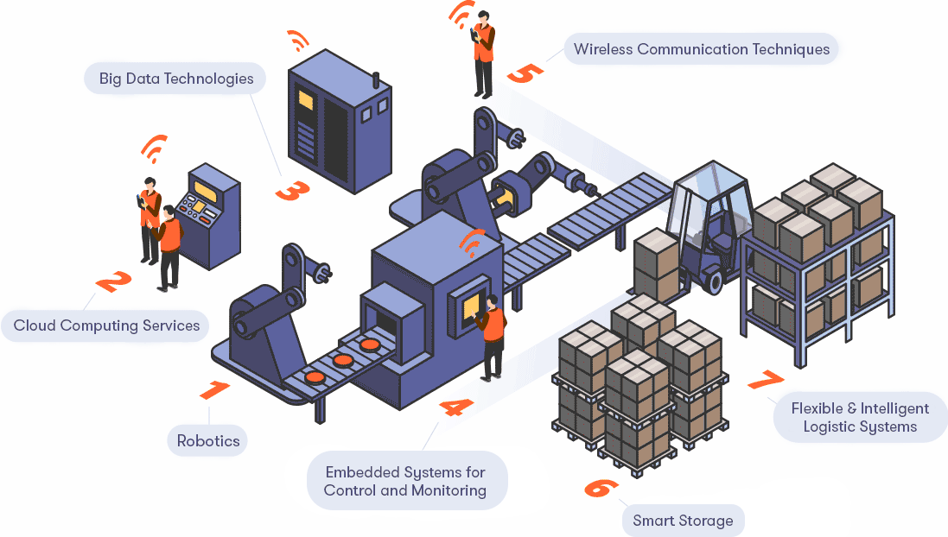
End Goal

Slide 10
AGENDA
1. PROJECT CONTEXT
2. ADDRESS PROBLEMS
3. PROJECT PIPELINE
4. DESIGN & DELIVER
5. Summary & Possible E2E Solution

Slide 11







PROJECT PIPELINE
Stake Holders
Business & Data Questions
Feedback
Image Data
Collection
Image
Pre-processing
Build
MODELs
Evaluation
Solutions

Slide 12
AGENDA
1. PROJECT CONTEXT
2. ADDRESS PROBLEMS
3. PROJECT PIPELINE
4. DESIGN & DELIVER
5. Summary & Possible E2E Solution

Slide 13
DATA INSIGHT (EDA)
Image resolution: 4096 (width) x 256 (height) pixels
Non_Defect_Image Sample
Defect_Image Sample
Mask_Image Sample
Image Data Source: https://www.aitex.es/afid/ : AFID: a public fabric image database for defect detection.

Slide 14
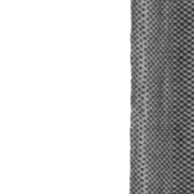
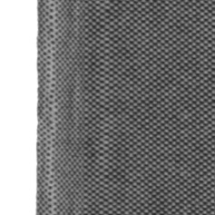

IMAGE PROCESSING
Non_Defect_Image pre-processing
 | Number of Images | PIXEL
Actual | 141 | 4096x256
Processed | 1240 | 256x256

Slide 15
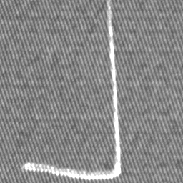
DEFECT TYPES
Broken end | 2 | Broken yarn | 6
Broken pick | 10 | Weft curling | 16
Fuzzyball | 19 | Cut selvage | 22
Crease | 23 | Warp ball | 25
Knots | 27 | Contamination | 29
Nep | 30 | Weft crack | 36

Slide 16
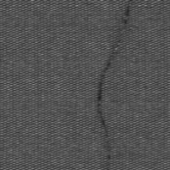
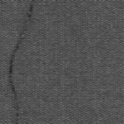


IMAGE PROCESSING
 | Number of Images | PIXEL
Actual | 107 | 4096x256
Defect_Image Sample
Mask_Image Sample
 | Number of Images | PIXEL
Processed | 358 | 256x256

Slide 17
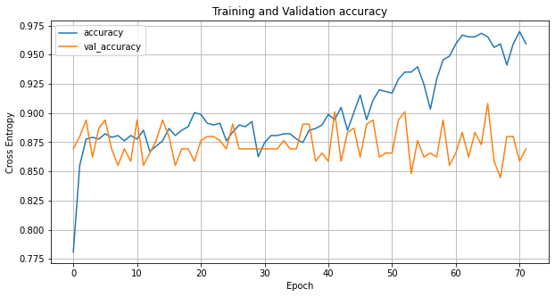
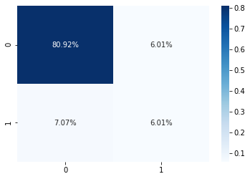
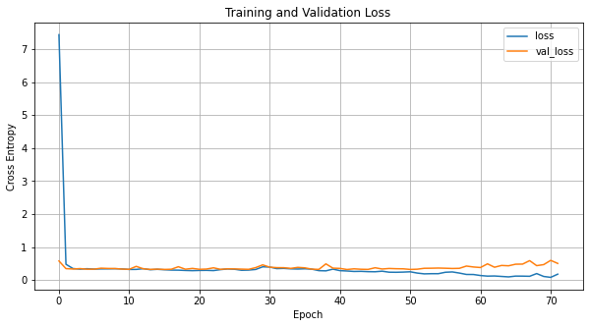
SIMPLE CNN MODELLING
NO IMAGE AUGMENTATION
DATA IMBALANCED
SIMPLE Sequential CNN
- Early Stopped at 70 Epochs
NO IMPROVEMENT ON
- VAL_ACC, VAL_LOSS
Metric | Score
Accuracy | 0.87
Recall | 0.46

Slide 18
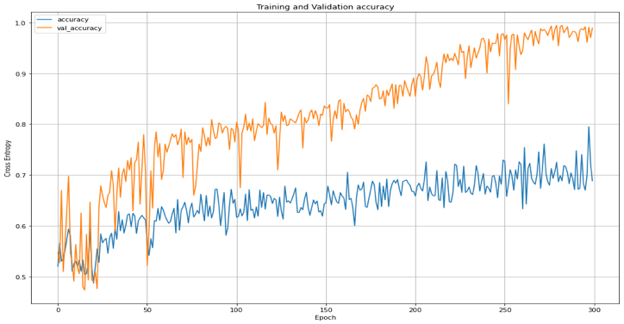
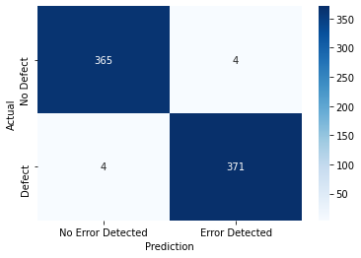
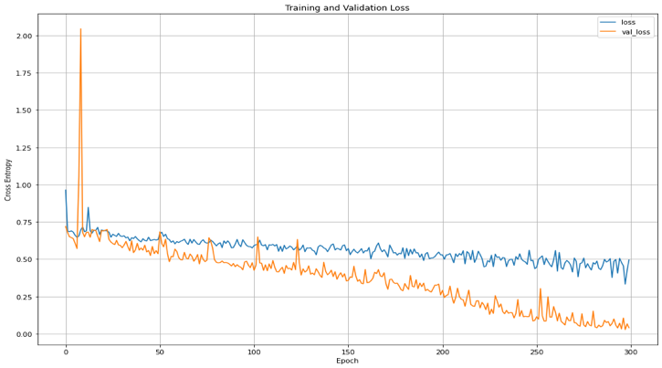
CNN MODEL Performance
Balance the data
Normalisation
Image serialization
Image Augmentation
Inception CNN
Metric | Score
Accuracy | 0.99
Recall | 0.99

Slide 19
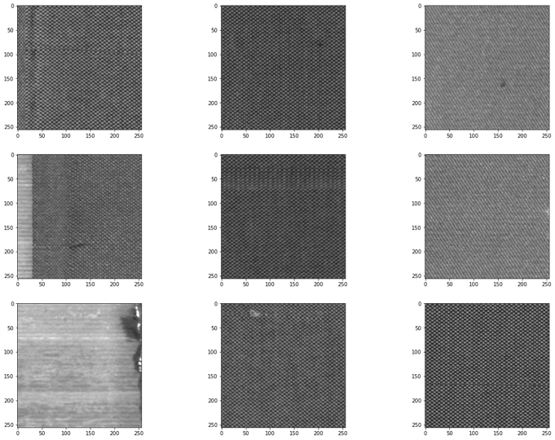
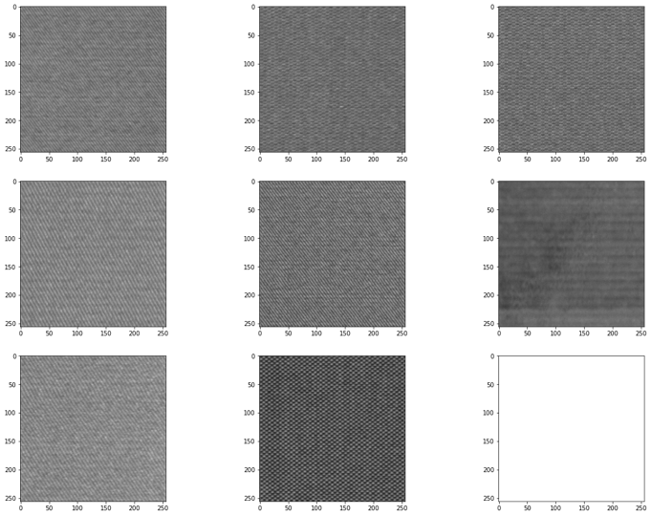
OUTPUT Samples
Detected Defect Images
Detected Non-Defect Images

Slide 20
AGENDA
1. PROJECT CONTEXT
2. ADDRESS PROBLEMS
3. PROJECT PIPELINE
4. DESIGN & DELIVER
5. Summary & Possible E2E Solution

Slide 21
Summary
DATA
Approach
Outcome
Original Image Data
Non-Defect: 140
Defect/Mask: 107
12 Defect Types
Image process
Normalisation
Oversample
- 2,480 images
Image Augmentation
Kaggle Notebook
Colab Notebook
Custom Inception CNN
Dropout
300 Epochs
99% Accuracy
99% Recall
Improvement of 29% on Detection rate

Slide 22
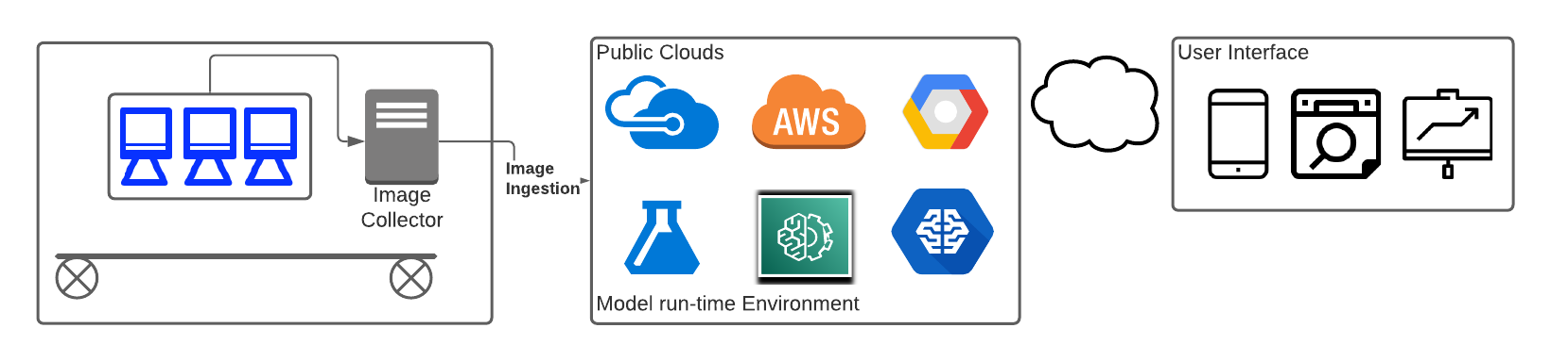
End to End Solution

Slide 23

THANK YOU Any Questions?
Many Thanks to Amin, Abhinav and Miruna!!
Supporting Git repo: https://github.com/sangdonlee/capstone

